Slide 1



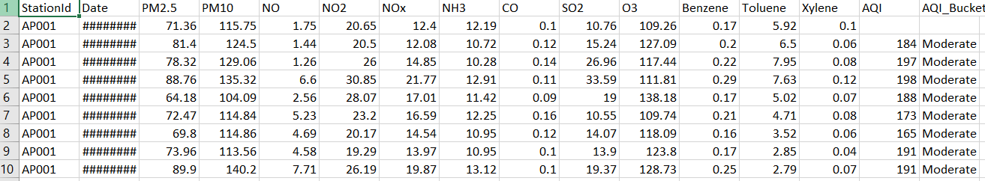
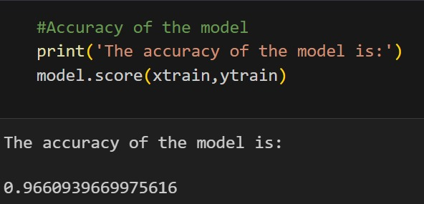
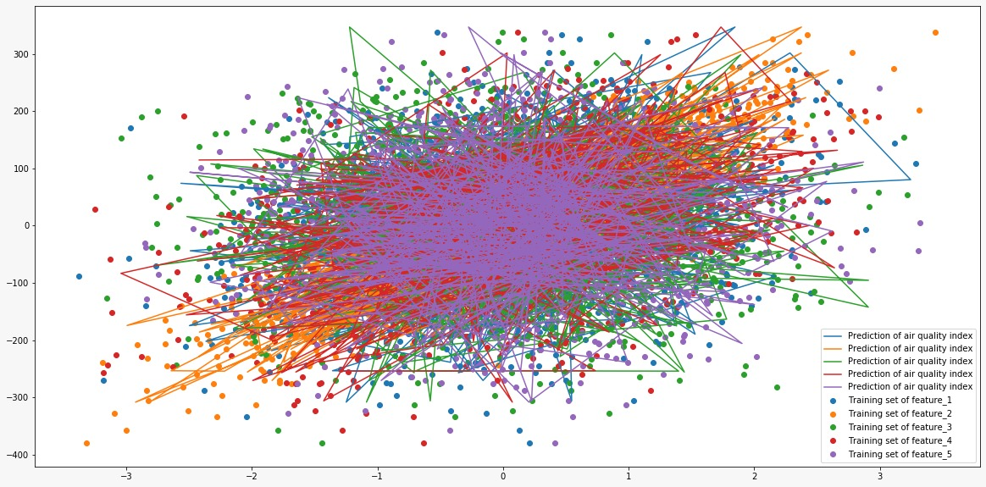
PROJECT TITLE
Department of Computer Science & Engineering
School of Computing
10214CS602– MINOR PROJECT-II
WINTER SEMESTER 2023-2024
ABSTRACT
INTRODUCTION
RESULTS
STANDARDS AND POLICIES
The purpose of the AQI is to educate the public on the negative health effects of local air pollution. An index for reporting air quality is called the air quality index (AQI). It measures the impact of air pollution on a person’s health over a short period of time.
The amount of air pollution in Indian cities has significantly increased. There are several ways to create a mathematical formula to determine the air quality index. Numerous studies have found a link between air pollution exposure and adverse health impacts in the population.Data mining techniques are one of the most interesting approaches to forecast AQI and analyze it. Predicting air quality index (AQI) using machine learning offers significant benefits in understanding and managing environmental health risks.This predictive capability enables proactive measures to mitigate pollution-related health issues, such as respiratory ailments and cardiovascular diseases, by informing decision-making processes for urban planning, transportation management, and industrial regulations.
Humans can only survive because of air. Its quality must be monitored and understood for our wellbeing. Due to air pollution, millions of people around the world suffer from physiological disorders and respiratory death.
According to scientific evidence, air pollution poses the single greatest environmental risk. Due to the toxic gas emissions caused by rapid industrialization, population levels have dramatically increased.
Our health is suffering greatly as a result of the air being contaminated by hazardous substances. Due to this unchecked pollution, air quality has significantly declined.
AQI is a numerical index used to measure and convey air pollution levels. The 12 parameters (air pollutants) used to calculate the AQI are NO2 (nitrogen dioxide), SO2 (sulfur dioxide), CO (carbon monoxide), O3 (ozone), PM10 (particulate matter having a diameter of 10 microns or less), PM2.5 (particulate matter having a diameter of 2.5 microns or less), NH3 (ammonia), and benzene.
In other applications, the six pollutants PM10, PM2.5, SO2, NO2, CO, and O3 are used to calculate the air quality index (AQI). A high AQI number indicates severely contaminated air, which can have a serious negative impact on health. Real-time air quality can be monitored using the AQI.
The proposed work compares a dataset’s effectiveness before and after using the SMOTE algorithm. The major novelty is the usage of SMOTE. Unlike other papers, the impact of an imbalanced dataset has been studied, and hence, SMOTE has been applied to balance it.The effectiveness of the suggested methods will aid in predicting future AQI levels, which can serve as a warning and emphasize the need of reducing air pollution levels.
The envisioned financial platform, with its comprehensive features such as currency exchange, appointment booking, and user-friendly interfaces, demonstrates a robust foundation for addressing the evolving needs of users in the financial sector. The project aims to streamline currency swaps, mitigate risks, and optimize financial transactions for a diverse user base, including individuals, businesses, and investors. Including user-centric functionalities, error handling, and advanced security measures aligns to provide a secure and seamless financial experience. To further enhance the platform, future considerations could include integrating advanced technologies like Al, machine learning, and blockchain, as well as expanding currency offerings to include cryptocurrencies. Continuous improvement, user feedback incorporation, and adaptability to technological advancements will be pivotal for ensuring the long-term success and relevance of the financial platform in the dynamic FinTech landscape.
Standards and policies for air quality index (AQI) prediction using machine learning vary depending on the jurisdiction and the specific application. However, some common principles and guidelines include:
1.Data Privacy and Security: Ensure that data used for AQI prediction is collected and stored in compliance with relevant privacy regulations, such as GDPR in Europe or CCPA in California.
2.Accuracy and Reliability: Develop machine learning models that provide accurate and reliable predictions of AQI.
3.Validation and Verification: Regularly validate and verify the performance of AQI prediction models against ground truth data and established benchmarks.
ACCURACY
DATASET
CONCLUSIONS
METHODOLOGIES
The analysis of air quality using machine learning techniques presents a promising avenue for understanding and predicting the intricate patterns of pollutants in the atmosphere. Through this project, a comprehensive exploration into the relationship between various environmental factors and air quality was conducted. The process involved data collection from diverse sources, preprocessing steps to handle missing values and outliers, and the extraction of meaningful features crucial for predicting air quality.
Click here to insert your Methods and Materials text. Type it in or copy and paste from your Word document or other source.
This text box will automatically re-size to your text. To turn off that feature, right click inside this box and go to Format Shape, Text Box, Autofit, and select the “Do Not Autofit” radio button.
To change the font style of this text box: Click on the border once to highlight the entire text box, then select a different font or font size that suits you. This text is Calibri 24pt and is easily read up to 4 feet away on a 24x48 poster, up to 6 feet away on a 36x72 poster, and up to 8 feet away on a 48x96 poster.
Zoom out to 100% (for 24x48), 150% (for 36x72), or 200% (for 48x96) to preview what this will look like on your printed poster.
Click here to insert your Methods and Materials text. Type it in or copy and paste from your Word document or other source.
This text box will automatically re-size to your text. To turn off that feature, right click inside this box and go to Format Shape, Text Box, Autofit, and select the “Do Not Autofit” radio button.
To change the font style of this text box: Click on the border once to highlight the entire text box, then select a different font or font size that suits you. This text is Calibri 24pt and is easily read up to 4 feet away on a 24x48 poster, up to 6 feet away on a 36x72 poster, and up to 8 feet away on a 48x96 poster.
Zoom out to 100% (for 24x48), 150% (for 36x72), or 200% (for 48x96) to preview what this will look like on your printed poster.
OUTPUT
TEAM MEMBER DETAILS
Predicting air quality index (AQI) using machine learning typically involves several steps:
Data Collection: Gather historical data on various air pollutants (such as PM2.5, PM10, CO, NO2, etc.), meteorological data (temperature, humidity, wind speed, etc.), and possibly geographical data (elevation, urban/rural classification, etc.).
Data Preprocessing: Clean the data by handling missing values, outliers, and inconsistencies. Perform feature engineering to create new features or transform existing ones to better represent the relationships in the data.
Feature Selection: Select the most relevant features that contribute the most to predicting AQI. This can be done using techniques like correlation analysis, feature importance scores from tree-based models, or domain knowledge.
Model Selection: Choose appropriate machine learning models for regression tasks, such as linear regression, decision trees, random forests, gradient boosting, or neural networks.
1.VTU19100/Vattikuntla.Anusha
2.VTU19219/Patnam.Nithin
3.VTU20437/Maddula.Bhanu
1.9515907747
2.8523014300
3.7386735965
1.VTU19100@veltech.edu.in
2.VTU19219@veltech.edu.in
3.VTU20437@veltech.edu.in
ACKNOWLEDGEMENT
1.MS.SUGANYA V/ASSISTANT PROFESSOR
2.Contact No:9791959857
3.Mail ID:vsuganya@veltech.edu.in

